Slide 1

PANIMALAR ENGINEERING COLLEGE ROAD ACCIDENT AUTOMATED RECOVERY PROCESS (RAARP) DOMAIN : MACHINE LEARNING
PROJECT GUIDE : BATCH NUMBER : 17
Mrs. S.T.SANTHANALAKSHMI., M.Tech (IT)., ASHWINI.K (211417104026)
ASSISTANT PROFESSOR (GRADE I) BHAVANA.P (211417104037)
DEPARTMENT OF CSE

Slide 2
ABSTRACT
Road accident are one of the major causes of human death. In this project we have investigated a practical and novel method of road accident automated recovery process which can real-time monitor.
The image processing and machine learning techniques are employed in surveillance system of power substation.
The video surveillance system automatically detecting the car number with sending mail to certain authorities and taking care of first aids.
If the car number are found with the accident detection ,his/her license plate(LP) number is recognized to initiate further actions such as deduction of penalty amount from one’s account linked with the vehicle license and Aadhar number by the traffic police and the legal authority.

Slide 3
LITERATURE SURVEY
Year | Author | Title | Description | Disadvantage
2019 (IEEE) | 1.Salaja silas 2.Rajsingh 3.Joyce beryl | Performance Analysis of Edge Detection Algorithms for Object Detection in Accident Images | Edge detection is used in identifying various objects such as vehicles and victims by outlining the sudden change of pixel intensity from the given accidental images. | Algorithms are evaluated in terms of Peak Signal-to-Noise Ratio (PSNR) and Mean Square Error (MSE) which delays the output.

Slide 4
LITERATURE SURVEY (CONT)
YEAR | AUTHOR | TITLE | DESCRIPTION | DISADVANTAGE
2019 (IEEE) | 1. Amrutha Madhusan 2.Lavanya Viswanathan 3. Vaishnavi Ravindran 4. Dr.Shanta Rangaswamy | A Survey on Road Accident Detection and Reporting | Two types of modules are used in this system , they are GPS and GSM where both are interfaced using serial communication with Micro electric sensor and vibrating sensor is used. | 1.If the interface is mislead , both GPS and GSM gets affected. 2. High cost 3.More number of sensors are used

Slide 5
LITERATURE SURVEY (CONT)
Year | Author | Title | Description | Disadvantage
2020 (IEEE) | 1.Pranav Chitale 2.Tanvi dhope 3.Amodh akhelikar 4.Surekha dholay | Smart Accident Recognition and Alerting System for Edge Devices | End to end deep learning solution to automate accident recognition and send real-time alerts to emergency services using the intel’s openVINO | For such pretrained models with your costume data is not always easy ,as not everything is well documented around re-traning/fine-tunning for all provided models

Slide 6
LITERATURE SURVEY (CONT)
YEAR | AUTHOR | TITLE | DESCRIPTION | DISADVANTAGE
2019 (IEEE) | 1.Earnest paul ljjina 2.Dhananjai chand 3.Savyasachi gupta 4. k.goutham | Computer Vision-Based Accident Detection in Traffic Surveillance | a neoteric framework for detection of road accident by framework capitalizes on mask R-CNN for accurate object detection followed by an efficient centroid based object tracking algorithm for surveillance footage | 1.Mask R-CNN is appropriate to use classification confidence to measure the mask quality since it only serves for distinguishing the semantic categories of proposals 2. Mask R-CNN is not aware of the actual quality

Slide 7
LITERATURE SURVEY (CONT)
YEAR | AUTHOR | TITLE | DESCRIPTION | DISADVANTAGE
2017 (IEEE) | 1.C. Vishnu 2.Dinesh Singh 3.C. Krishna Mohan 4.Sobhan Babu | Detection of Motorcyclists without Helmet in Videos using Convolutional Neural Network | a framework for automatic detection of motorcyclists driving without helmets in surveillance videos | 1. It cannot detect the motorcycles. 2. In this way we can detect only the motorcyclist without helmet 3. high cost. 4. we cannot detect automatically.

Slide 8
PROBLEM STATEMENT
This article presents an intelligent video surveillance system for automatically detecting the accident and Car Number with sending mail with immediate first aid actions and reduce the probability of deaths taking place.
And also if the car number are found with accident detection, his/her license plate (LP) number is recognized to initiate further actions such as deduction of penalty amount from one's account linked with the vehicle license and Aadhar Number (Applicable to Indian Scenario) by the traffic police and the legal authority.
Is video can be viewed for later use? Police and other law officials can review local traffic videos to search for the license plates of accidental car and also stolen vehicles or suspected cars in other crimes.

Slide 9
TECHNOLOGY STACK
HARDWARE REQUIREMENTS
Processor - pentium IV 2.4GHZ.
RAM - 4GB
ROM - 1TB
Cache memory - 512KB
CCTV camera - ADVANCED
SOFTWARE REQUIREMENTS
Operating System - Windows XP Professionals

Slide 10


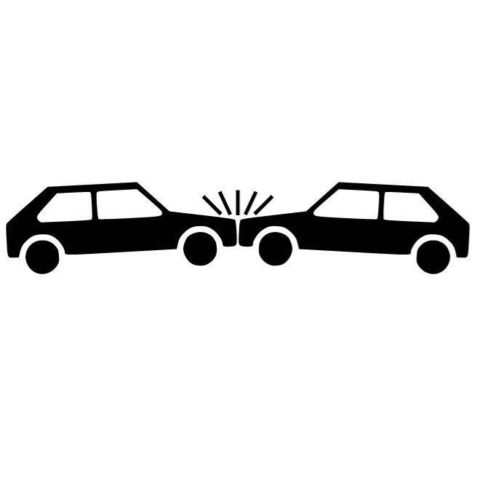
SYSTEM ARCHITECTURE
Cloud Server
CCTV Camera
Wifi Hotspot
Centralized station
Accident Spot

Slide 11
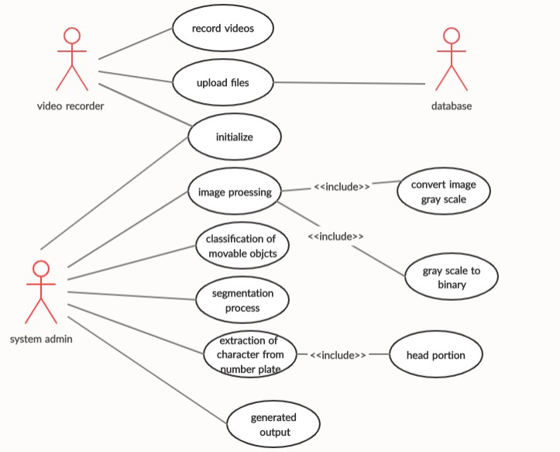
SYSTEM DESIGN – USECASE DIAGRAM

Slide 12
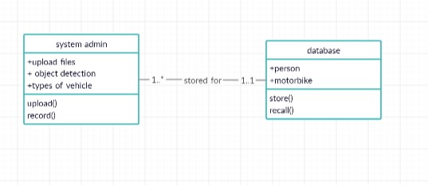
CLASS DIAGRAM

Slide 13
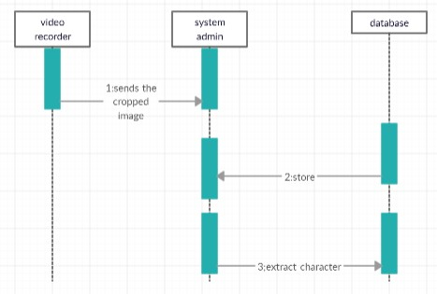
SEQUENCE DIAGRAM

Slide 14
MODULES
List of Module
1.Classification of movable objects
2. Segmentation
3. Recognition of characters

Slide 15
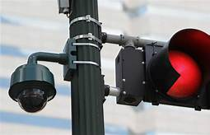
1.CLASSIFICATION OF MOVABLE OBJECTS
The surveillance camera that capture the movable objects from the traffic road. And it uploads to the database which is already created to store the video files for the further uses based on the needs of the system admin.
It uploads the video from the camera and stores the video in the database.
Admin uses the multiple functions to be done in the class

Slide 16
2. SEGMENTATION
Segmentation means to divide the frames into parts, or segments, which are definable, accessible, actionable, and profitable and have a growth potential.
Once the person-Car pair is obtained, the person images is given as input to accident detection model.
The file size may not be matter at all. Because the memory that can enlarge with the high level. It converts the images to grayscale images and it is common way to image processing
They recognize the multiple of the objects from the videos using the algorithm which is based on the image processing.

Slide 17
3. RECOGNITION OF CHARACTERS
Automatic number-plate recognition is a technology that uses optical character recognition on images to read vehicle registration plates to create vehicle location data . Video Relay Interpreting(VRI) is used by police forces around the world for law enforcement purposes, including to check if a vehicle is registered or licensed. Video Relay Interpreting (VRI) can be used to store the images captured by the cameras as well as the text from the license plate, with some configurable to store a photograph of the driver.
Systems commonly use infrared lighting to allow the camera to take the picture at any time of day or night. Then optical character recognition (OCR) to extract the alphanumerics of the license plate.

Slide 18
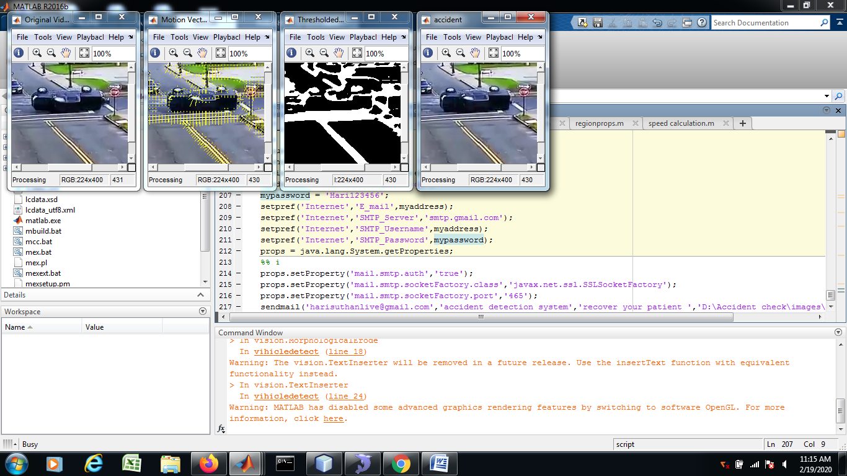
SAMPLE SCREENSHOT

Slide 19
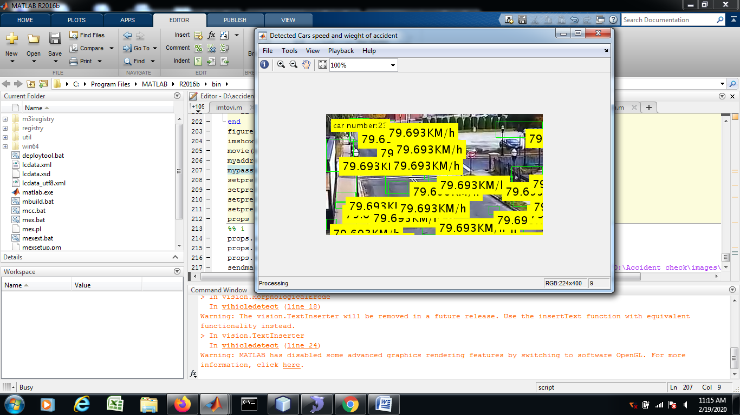
SCREENSHOT-CONT

Slide 20
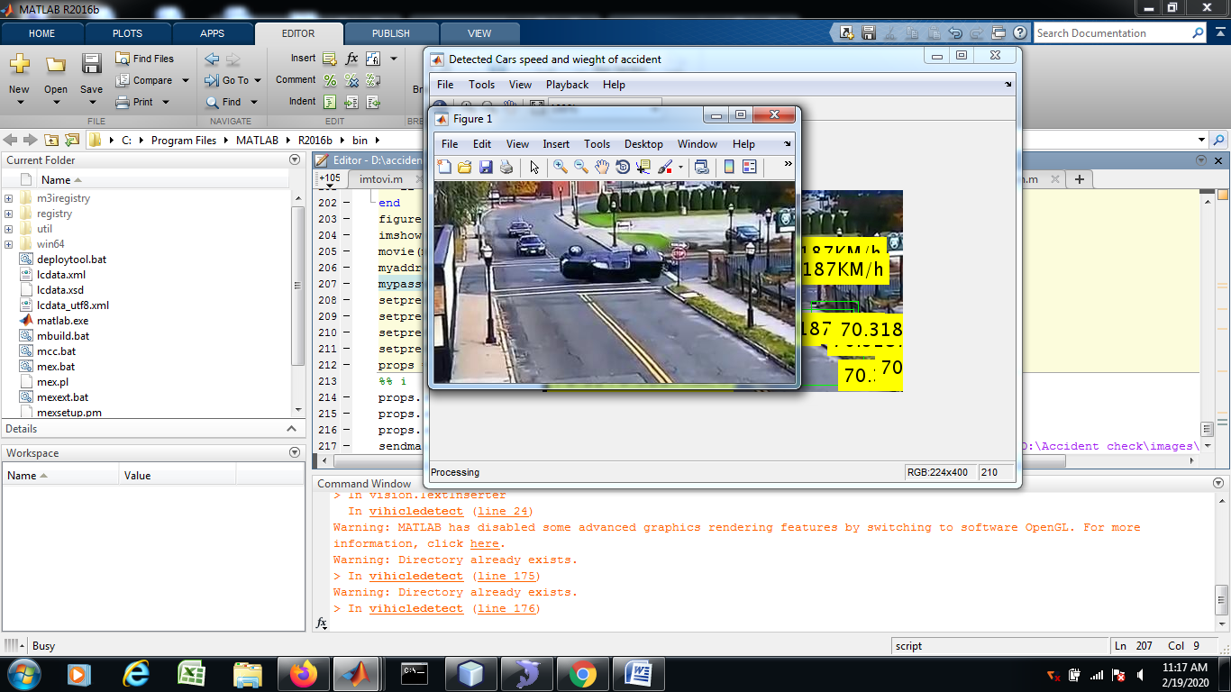
SCREENSHOT-CONT

Slide 21
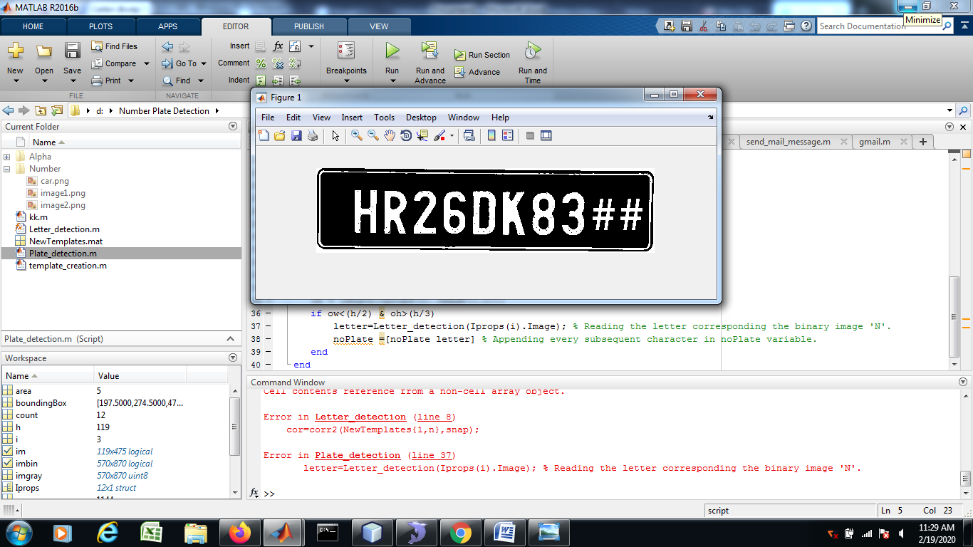
SCREENSHOT-CONT

Slide 22
CONCLUSION
This methods are efficient to detect accidents using both hardware and software methods which provide good results. Most of the discussed methods also provide the driver with the option of turning of the alarm in cases where the accident is not serious or false detections of an accident.
Previous methods are either mostly dependent on some hardware like sensors that have to be present in the car or require a smart phone to be present within the car. While the use of such hardware can prove to be a more cost-efficient approach it has the drawback of being destroyed in the accident and hence giving spurious or no readings at all.
Hence, an approach that does not depend on any hardware device or sensor that is associated with the car is required for the detection of traffic accidents.

Slide 23
REFERENCE
B. Prachi, D. Kasturi and C. Priyanka, "Intelligent Accident-Detection And Ambulance- Rescue System", International Journal Of Scientific & Technology Research, Vol. 3, No. 6, 2016.
M. Ruikar, "National statistics of road traffic accidents in India", Journal of Orthopedics, Traumatology and Rehabilitation, vol. 6, no. 1, p. 1, 2013.
T. Rahman, "Road Accidents in Bangladesh: An Alarming Issue", The World Bank, 2012. [Online]
M. M. L. Elahi, R. Yasir, M. A. Syrus, M. S. Q. Z. Nine, I. Hossain and N. Ahmed, "Computer vision based road traffic accident and anomaly detection in the context of Bangladesh," 2014 International Conference on Informatics, Electronics & Vision (ICIEV), Dhaka, 2014, pp. 1-6
P. A. Nandurge and N. V. Dharwadkar, "Analyzing road accident data using machine learning paradigms," 2017 International Conference on I- SMAC (IoT in Social, Mobile, Analytics, and Cloud) (I-SMAC), Palladam, 2017, pp. 604-610
K. M. Habibullah, A. Alam, S. Saha, A. Amin and A. K. Das, " A Driver- Centric Carpooling: Optimal Route-Finding Model using Heuristic Multi– Objective Search," 2019 4th International Conference on Computer and Communication Systems (ICCCS), Singapore, 2019
Conference on Statistics in Science, Business and Engineering (ICSSBE), Langkawi, 2012, pp. 1-4.
I. Rish, "An Empirical Study of the Naïve Bayes Classifier," IJCAI 2001 Work Empir Methods Artif Intell (2001), vol

Slide 24
THANK YOU

